Slide 1
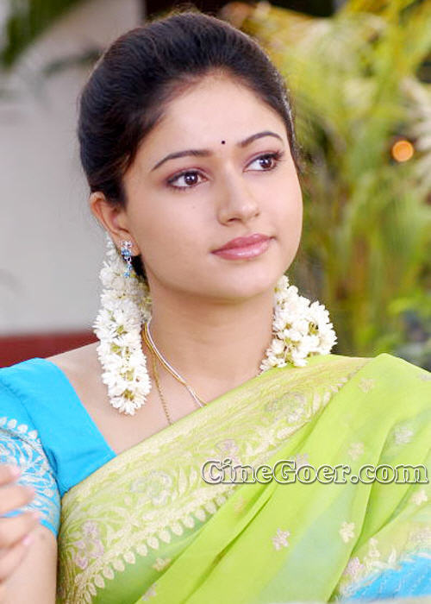
Hair
Eye
Ear
Nose

